Slide 1
AZ-104T00A Administer Identity

Slide 2

Administer Identity Introduction
Configure Azure Active Directory
Configure User and Group Accounts
Lab 01 - Manage Azure Active Directory Identities

Slide 3
Configure Azure Active Directory

Slide 4
Configure Azure Active Directory Introduction
Describe Azure Active Directory Benefits and Features
Describe Azure AD Concepts
Compare AD DS to Azure Active Directory
Select Azure AD Editions
Implement Azure AD Device Identities
Implement Self-Service Password Reset
Summary and Resources
Notes:
Manage Azure identities and governance (15-20%)
Manage Azure AD objects
Configure Azure AD join
Configure self-service password reset

Slide 5
Why use an identity?
To be able to prove what we are | Authentication
To get permission to do something | Authorization
To report on what was done | Auditing
To be able to (self) administer an identity | Administration
Authentication
Authorization
Administration
Auditing
Track who does what, when, where and how
Focused alerting
In-depth collated reporting
Governance & compliance
User sign-on experience
Trusted source(s)
Federative protocols
Level of assurance
How and where are authorizations handled
Can a user access the resource and what can they do when they access it?
Single view management
Application of business rules
Automated requests, approvals, and access assignment
Entitlement management

Slide 6
History of Microsoft Identity Systems
Microsoft has been a major player in the identity and access management space since around 2000 – with the release of Windows Server 2000 and Active Directory. Microsoft won most of the market share from Novell Netware.
Active Directory is Microsoft's implementation of an LDAP system which provided authentication, authorisation and access management to Windows based system. These systems are known as domains.
Servers which run Active Directory are known as Domain Controllers.
Legacy applications can be integrated with Active Directory to provide Same Sign On to enterprise users allowing an application front end to leverage the AD credentials.
Legacy application which integrate with Active Directory typically use Kerberos and/or NTLM authentication protocols.

Slide 7
Describe Azure Active Directory Benefits and Features
A cloud-based suite of identity management capabilities that enables you to securely manage access to Azure services and resources for your users
Provides application management, authentication, device management, and hybrid identity
Notes:
What is Azure Active Directory? - https://docs.microsoft.com/azure/active-directory/fundamentals/active-directory-whatis
Azure Active Directory (Azure AD) is Microsoft's multi-tenant cloud-based directory and identity management service. Azure AD helps to support user access to resources and applications, such as:
Internal resources and apps located on your corporate network.
External resources like Microsoft 365, the Azure portal, and SaaS applications.
Cloud apps developed for your organization.
The following diagram shows an example implementation of Azure AD. In this scenario, Windows Server AD is using Kerberos and NTLM authentication to on-premises applications.
Stress how Kerberos and NTLM are legacy authentication protocols but that many application might still leverage them.

Slide 8
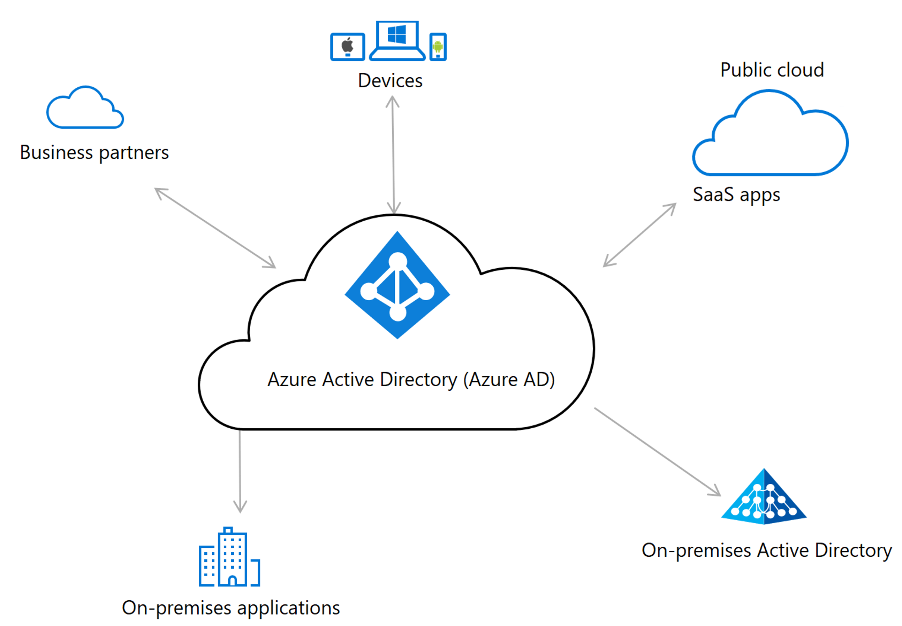
Identity and Access Management Solutions
An identity solution controls access to an organization's apps and data. Users, devices, and applications have identities.
Notes:
An identity solution controls access to an organization's apps and data. Users, devices, and applications have identities. IAM components support the authentication and authorization of these and other identities. The process of authentication controls who or what uses an account. Authorization controls what that user can do in applications.
Whether you're just starting to evaluate identity solutions or looking to expand your current implementation, Azure offers many options. One example is Azure Active Directory (Azure AD), a cloud service that provides identity management and access control capabilities. To decide on a solution, start by learning about this service and other Azure components, tools, and reference architectures.

Slide 9
Describe Azure AD Concepts
Concept | Description
Identity | An object that can be authenticated
Account | An identity that has data associated with it
Azure AD account | An identity created through Azure AD or another Microsoft cloud service
Azure AD tenant/directory | A dedicated and trusted instance of Azure AD, a Tenant is automatically created when your organization signs up for a Microsoft cloud service subscription​ ​ Additional instances of Azure AD can be created​ Azure AD is the underlying product providing the identity service​ The term Tenant means a single instance of Azure AD representing a single organization​ The terms Tenant and Directory are often used interchangeably​
Azure subscription | Used to pay for Azure cloud services
Notes:
Azure AD Terminology - https://docs.microsoft.com/azure/active-directory/fundamentals/active-directory-whatis#terminology

Slide 10
Compare AD DS to Azure Active Directory
Azure AD is primarily an identity solution, and designed for HTTP and HTTPS communications
Queried using the REST API over HTTP and HTTPS. Instead of LDAP
Uses HTTP and HTTPS protocols such as SAML, WS-Federation, and OpenID Connect for authentication (and OAuth for authorization). Instead of Kerberos
Includes federation services, and many third-party services (such as Facebook)
Azure AD users and groups are created in a flat structure, and there are no Organizational Units (OUs) or Group Policy Objects (GPOs)
Notes:
Compare Active Directory to Azure Active Directory - https://docs.microsoft.com/azure/active-directory/fundamentals/active-directory-compare-azure-ad-to-ad
✔️ Azure AD is a managed service. You only manage the users, groups, and policies. Deploying AD DS with virtual machines using Azure means that you manage the deployment, configuration, virtual machines, patching, and other backend tasks. Do you see the difference? How are they similar?

Slide 11
Compare AD DS to Azure Active Directory
Identity solution: AD DS is primarily a directory service, while Azure AD is a full identity solution.
Communication protocols: Because Azure AD is based on HTTP and HTTPS, it doesn't use Kerberos authentication. Azure AD implements HTTP and HTTPS protocols, such as SAML, WS-Federation, and OpenID Connect for authentication (and OAuth for authorization).
Federation services: Azure AD includes federation services, and many third-party services like Facebook.
Managed service: Azure AD is a managed service. You manage only users, groups, and policies. If you deploy AD DS with virtual machines by using Azure, you manage many other tasks, including deployment, configuration, virtual machines, patching, and other backend processes.
Legacy management concepts such as Group Policy (GPOs) and Organisational Units (OUs) do not exist on Azure AD.
REST API queries: Azure AD is based on HTTP and HTTPS protocols. Azure AD tenants can't be queried by using LDAP. Azure AD uses the REST API over HTTP and HTTPS.

Slide 12
Select Azure Active Directory Editions
Feature | Free | Microsoft 365 Apps | Premium P1 | Premium P2
Directory Objects | 500,000 objects | No object limit | No object limit | No object limit
Single Sign-On | Unlimited | Unlimited | Unlimited | Unlimited
Core Identity and Access | X | X | X | X
B2B Collaboration | X | X | X | X
Identity & Access for O365 |  | X | X | X
Premium Features |  |  | X | X
Hybrid Identities |  |  | X | X
Advanced Group Access |  |  | X | X
Conditional Access |  |  | X | X
Identity Protection |  |  |  | X
Identity Governance |  |  |  | X
Notes:
Azure AD Pricing Editions - https://azure.microsoft.com/pricing/details/active-directory/
✔️ Did you look through the pricing list to determine which features your organization needs and to compare edition capabilities?

Slide 13
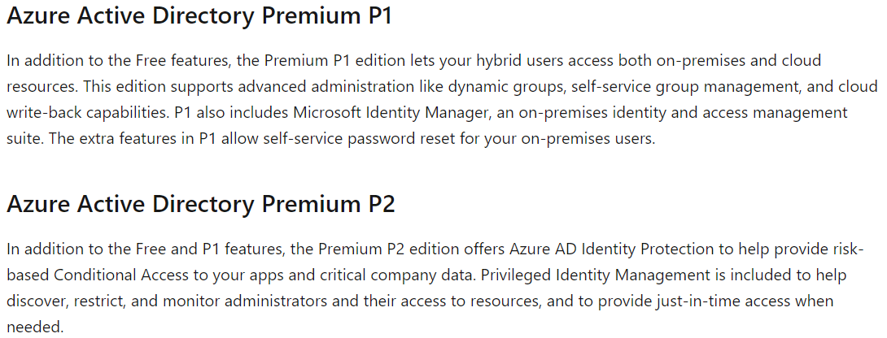
Azure AD Licenses
Every organisation who are already using Microsoft 365 or Dynamics already have an instance of Azure AD. This is the directory which is represented by domain.onmicrosoft.com.

Slide 14



Configure Azure AD Device Identities
Azure AD registered devices | Azure AD joined devices | Hybrid Azure AD joined devices
Supports Bring Your Own Device Registered devices sign-in using a Microsoft account Attached to an Azure AD account granting access to resources Control using Mobile Device Management (MDM) tools like Microsoft Intune OS – Windows 10⁺, iOS, Android, and MacOS | Intended for cloud-first or cloud-only organizations Organization-owned devices Joined only to Azure AD - organizational account required Can use Conditional Access policies OS – Windows 10⁺ devices | You have Win32 apps deployed to these devices using Active Directory machine authentication You want to continue to use Group Policy to manage the device You want to use existing image solutions to deploy devices OS - Windows 7⁺ devices
Notes:
This slide used to just be only about Azure AD Join.
Azure AD registered devices - https://docs.microsoft.com/azure/active-directory/devices/concept-azure-ad-register
Azure AD joined devices - https://docs.microsoft.com/azure/active-directory/devices/concept-azure-ad-join
Hybrid Azure AD joined devices - https://docs.microsoft.com/azure/active-directory/devices/concept-azure-ad-join-hybrid
Device identies are used to help administrators making access and policy decisions – which dictated what services they can access.

Slide 15
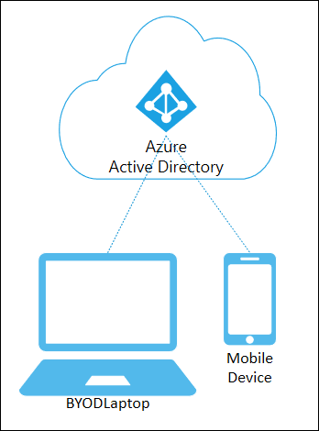
AAD Registered Devices
Device is typically owned by an individual.
Must be Windows 10 or newer.
Supports BYOD scenarios for corporate system access.
Light-touch corporate policy can be applied to maintain security baseline.
Conditional Access policies can be applied.
Intune compliance policy can prevent things such as rooted Android and/or jailbroken iPhones to connect.

Slide 16
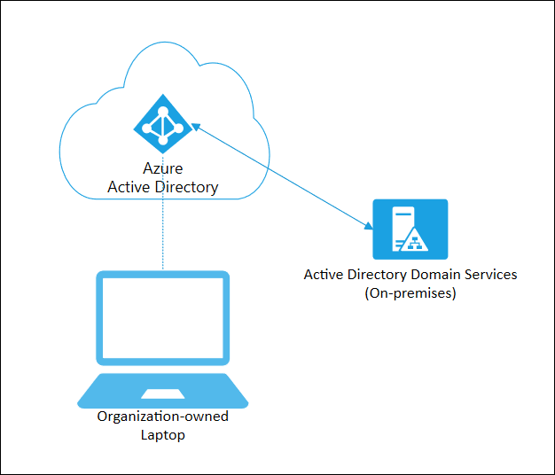
AAD Joined Devices
For company owned assets with full control over configuration.
MDM tools such as ConfigMgr and Intune can be used to dictated configuration and policy settings.
Devices can be enrolled by self-service, bulk import or with Windows Autopilot.
Users can sign in with AAD cloud accounts or even synced AD DS credentials.
Goal is to provide cloud-based management. No traditional GPO’s are possible.

Slide 17
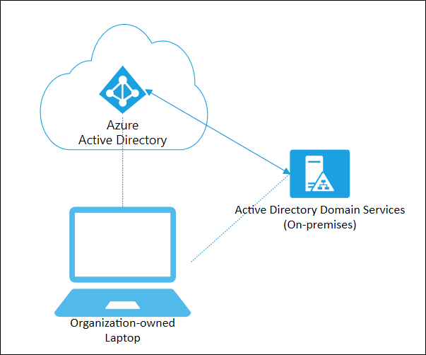
Hybrid Azure AD Joined
Used when organisations want to enjoy cloud-based management for devices which are still joined to AD DS.
Hybrid Azure AD must have connectivity to a traditional Domain Controller.
Supports down level Operating Systems dating back to Windows 8.1
Allows traditional GPOs to be leveraged whilst being manageable objects in AAD.
Ensures machine-based authentication is still possible.

Slide 18
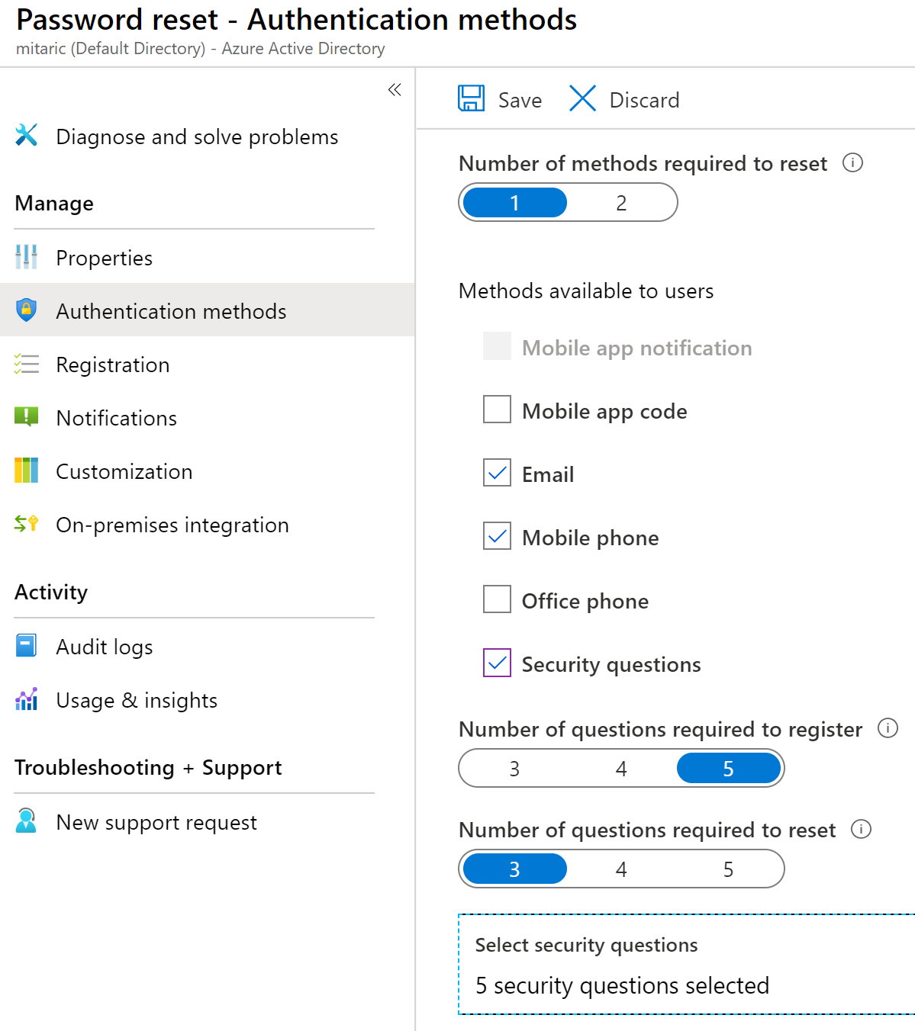
Implement Self-Service Password Reset
Determine who can use self-service password reset
1
2
Choose the number of authentication methods required and the methods available (email, phone, questions)
3
You can require users to register for SSPR (same process as MFA)
Notes:
Plan an Azure Active Directory self-service password reset deployment - https://docs.microsoft.com/azure/active-directory/authentication/howto-sspr-deployment

Slide 19
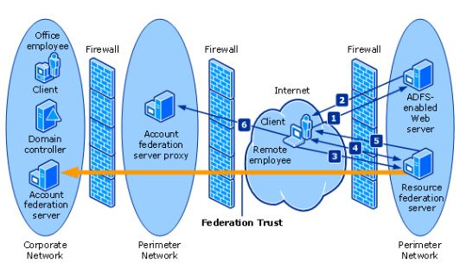
What is Federation?

Slide 20
Federated identity concepts
Federation is a collection of domains that have established trust. The level of trust may vary, but typically includes authentication and almost always includes authorization.
SAML – Security Assertion Markup Language
Open standard for exchanging authentication and authorization data between an identity provider and a service provider.
The principal, generally a user
The identity provider (IdP)
The service provider (SP)
WS-Fed – Web Services Federation
An identity specification from Web Services Security framework to provide single-sign-on via external identity exchange and authentication.
OpenID Connect (OIDC)
OIDC extends the OAuth 2.0 authorization protocol for use as an authentication protocol, so that you can do single sign-on using OAuth.
Notes:
OpenID Connect (OIDC) – introduces the security token.

Slide 21
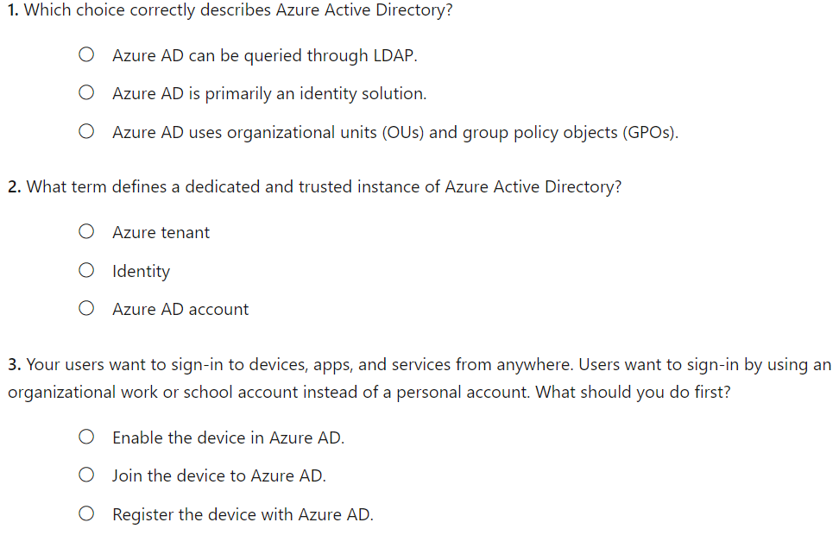
Knowledge Check
Notes:
What is the difference between a tenants and AAD?
B
A
B

Slide 22
Summary and Resources – Configure Azure Active Directory
Knowledge Check
Microsoft Learn Modules (docs.microsoft.com/Learn)
Allow users to reset their password with Azure Active Directory self-service password reset (Sandbox)
Manage device identity with Azure AD join and Enterprise State Roaming
Implement and manage hybrid identity
A sandbox indicates a hands-on exercise.
Notes:
Learn - https://docs.microsoft.com/learn/browse/
Although Hybrid Identities is not on the exam, there is Learn content if a student is interested.
The Assessment Guide in the MCT DLC has open-ended questions.
Describe the following concepts: identity, account, Azure AD account, Azure AD Account, Azure AD tenant, and Azure subscription. How are these different?
Answer: Identity is an object that can be authenticated. An Account is an identity that has data associated with it. An Azure AD account is an identity created through Azure AD or another Microsoft cloud service. An Azure AD tenant is a dedicated and trusted instance of Azure AD, A Tenant is automatically created when your organization signs up for a Microsoft cloud service subscription​. An Azure subscription is used to pay for Azure cloud services.
How is Azure Active Directory different from Azure Active Directory Domain Services?
Answer: Azure AD is primarily an identity solution and designed for HTTP and HTTPS communications. Azure AD can be queried with a REST API, instead of LDAP. Azure AD uses federation services, and many third-party services (such as Facebook). Azure AD users and groups are created in a flat structure. Azure AD does not have Organizational Units (OUs) or Group Policy Objects (GPOs).
Describe the Self-Service Password Reset authentication methods can be configured for users.
Answer: Self-Service Password Reset authentication methods include mobile app notification, mobile app code, email, mobile phone, office phone, and security questions. A combination of authentication methods can be used.

Slide 23
Configure User and Group Accounts

Slide 24


Configure User and Group Accounts Introduction
Create User Accounts
Manage User Accounts
Create Bulk Accounts
Create Group Accounts
Assign Licenses to Users and Groups (extra topic)
Create Administrative Units
Demonstration – Users and Groups
Summary and Resources
Notes:
Manage Azure identities and governance (15-20%)
Manage Azure AD objects
Create users and groups
Manage user and group properties
Perform bulk user updates
Manage guest accounts

Slide 25
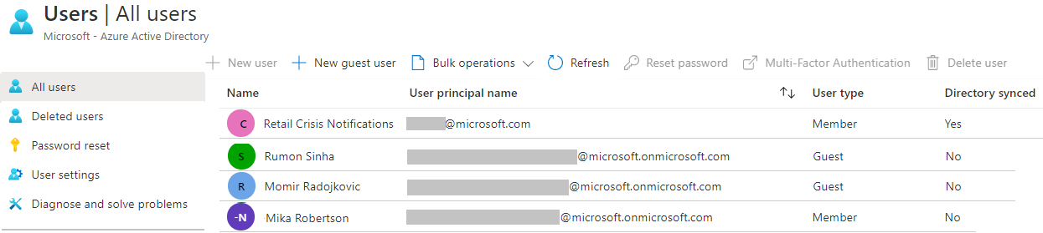
Create User Accounts
All users must have an account
The account is used for authentication and authorization
Each user account has additional properties
Notes:
✔️ Have you given any thought as to the type of users you will need?

Slide 26
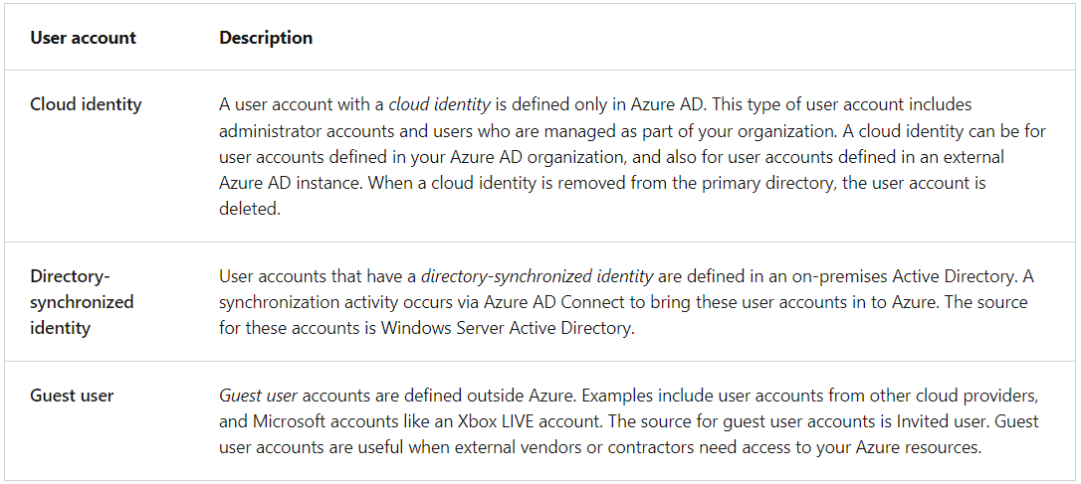
Types of Users to Consider
Notes:
Consider where users are defined. Determine where your users are defined. Are all your users defined within your Azure AD organization, or are some users defined in external Azure AD instances? Do you have users who are external to your organization? It's common for businesses to support two or more account types in their infrastructure.
Consider support for external contributors. Allow external contributors to access Azure resources in your organization by supporting the Guest user account type. When the external contributor no longer requires access, you can remove the user account and their access privileges.
Consider a combination of user accounts. Implement the user account types that enable your organization to satisfy their business requirements. Support directory-synchronized identity user accounts for users defined in Windows Server Active Directory. Support cloud identities for users defined in your internal Azure AD structure or for user defined in an external Azure AD instance.

Slide 27
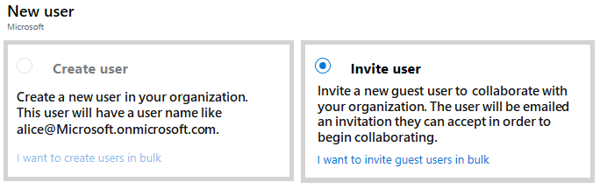
Manage User Accounts
Must be Global Administrator or User Administrator to manage users
User profile (picture, job, contact info) is optional
Deleted users can be restored for 30 days
Sign in and audit log information is available
Notes:
Add or delete users using Azure Active Directory - https://docs.microsoft.com/azure/active-directory/fundamentals/add-users-azure-active-directory

Slide 28
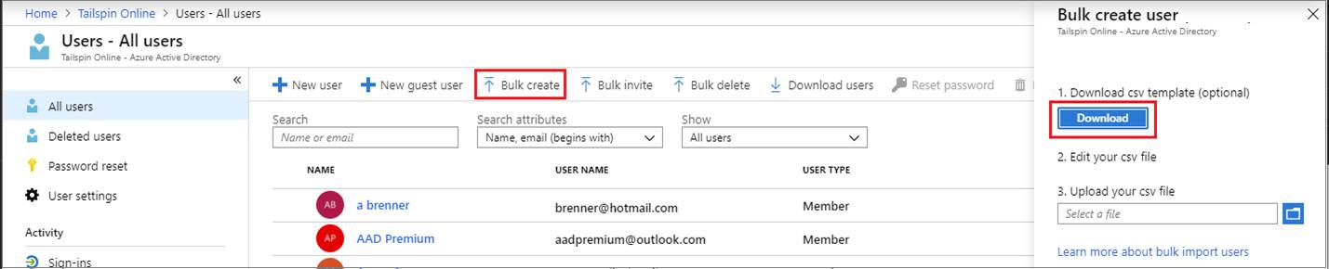
Perform bulk account updates
Azure AD supports bulk user and group member updates
Create the comma-separated values (CSV) template you can download from the Portal
Must be signed in as a Global administrator or User administrator
Notes:
The latest JTA (Jan 2022) now states, Perform bulk updates. Previously this was just bulk user accounts.
Bulk create users in Azure Active Directory - https://docs.microsoft.com/azure/active-directory/users-groups-roles/users-bulk-add
Bulk add group members in Azure Active Directory - https://docs.microsoft.com/azure/active-directory/enterprise-users/groups-bulk-import-members
✔️ Establish or implement a naming convention for usernames, display names and aliases. The password for the new users needs to conform to the password complexity rules you have set for your directory. User parameters include User Principal Name, Display Name, Given Name, Department, and Job Title.

Slide 29
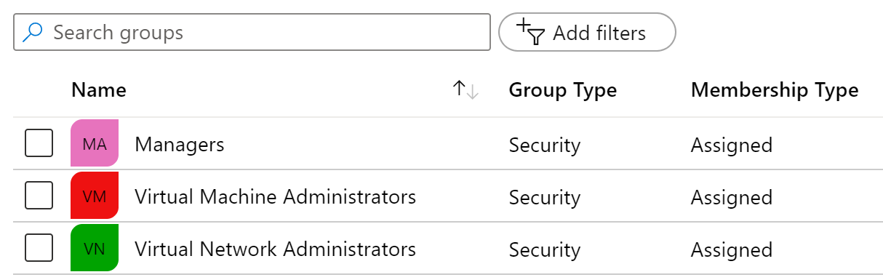
Create Group Accounts
Group Types
Security groups
Microsoft 365 groups
Assignment Types
Assigned
Dynamic User
Dynamic Device (Security groups only)
Notes:
Manage app and resource access using Azure Active Directory groups – https://docs.microsoft.com/azure/active-directory/fundamentals/active-directory-manage-groups
Quickstart: View your organization's groups and members in Azure Active Directory - https://docs.microsoft.com/azure/active-directory/fundamentals/active-directory-groups-view-azure-portal
✔️ Have you given any thought to which groups you need to create? How will you assign users to groups?

Slide 30
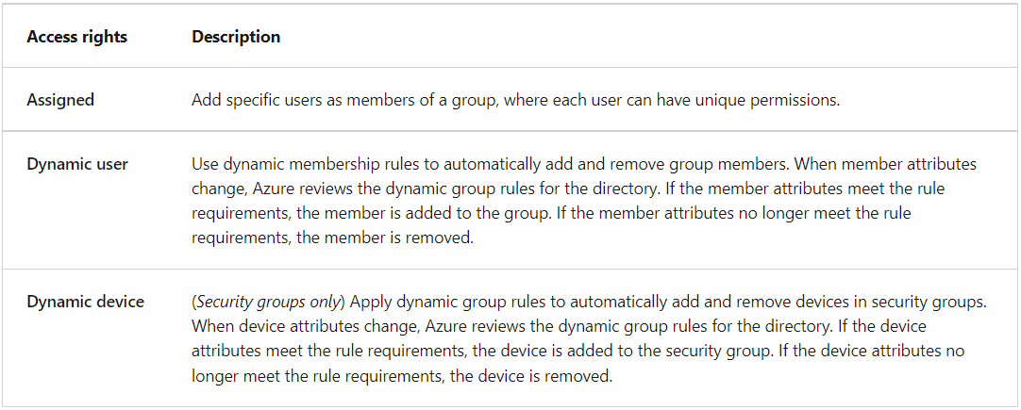
Things to Consider about Groups in AAD?

Slide 31
Assign Licenses to Users and Groups
Microsoft Azure is a cloud service that provides many built-in services for free.
Azure AD comes as a free service
Gain additional Azure AD functionality with a P1 or P2 license
View license plans and plan details
Set the Usage Location parameter
Assign licenses to users and groups
Change license plans for users and groups
Remove a license
Additional Services (like O365 are paid cloud services)
Microsoft paid cloud services require licenses
Licenses are assigned to those who need access to the services
Each user or group requires a separate paid license
Administrators use management portals and PowerShell cmdlets to manage licenses
Notes:
Assign or remove licenses in the Azure Active Directory portal - https://docs.microsoft.com/azure/active-directory/fundamentals/license-users-groups
Choose the best license for your business - https://www.microsoft.com/security/business/identity-access-management/azure-ad-pricing?rtc=1#office-SKUChooser-q6q98uk
Take a minute to show in the Portal the basic licensing tasks. This topic is not in the student content.

Slide 32
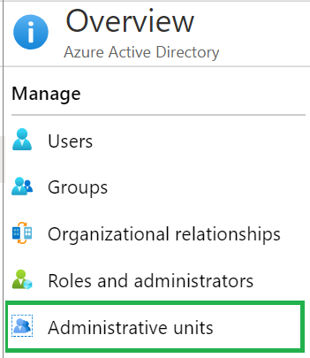
Create Administrative Units
Create an administrative unit
Populate the administrative unit with Azure AD users or groups
Create a role with appropriate permissions scoped to the administrative unit
Add IT members to the role
Azure AD Premium P1 or P2 for each Privileged Role Administrator or Global Administrator
Notes:
It can be useful to restrict administrative scope by using administrative units in organizations that are made up of independent divisions of any kind. Consider the example of a large university that's made up of many autonomous schools (School of Business, School of Engineering, and so on). Each school has a team of IT admins who control access, manage users, and set policies for their school.
A central administrator could:
Administrative Units in Azure AD - https://docs.microsoft.com/azure/active-directory/roles/administrative-units
Create a role with administrative permissions over only Azure AD users in the business school administrative unit.
Create an administrative unit for the School of Business.
Populate the administrative unit with only the business school students and staff.
Add the business school IT team to the role, along with its scope.

Slide 33
Demonstration – Users and Groups
Determine domain information
Explore user accounts
Explore group accounts
Explore PowerShell for group management
Notes:
✔ Always consider having students walk-through the demonstrations themselves. Also, consider the overlap with the formal labs and your best use of time.
Use the Demonstration in the MCT DLC, or one of the Quickstart tutorials.
Add or delete users using Azure Active Directory - https://docs.microsoft.com/azure/active-directory/fundamentals/add-users-azure-active-directory
Create a basic group and add members using Azure Active Directory - https://docs.microsoft.com/azure/active-directory/fundamentals/active-directory-groups-create-azure-portal

Slide 34
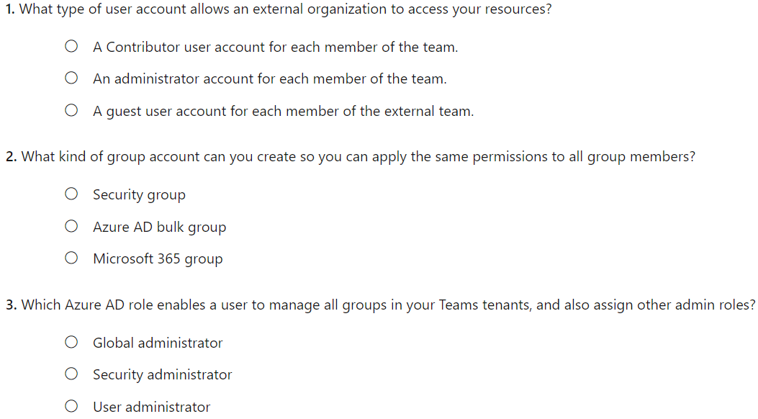
Knowledge Check
Notes:
C
A
A

Slide 35
Summary and Resources – Configure User and Group Accounts
Knowledge Check
Microsoft Learn Modules (docs.microsoft.com/Learn)
Create Azure users and groups in Azure Active Directory (Sandbox)
Manage users and groups in Azure Active Directory
A sandbox indicates a hands-on exercise.
Notes:
Learn - https://docs.microsoft.com/learn/browse/
The Assessment Guide in the MCT DLC has open-ended questions.
List three features of a user account and two ways a user can be assigned to group.
Answer: All users must have a user account. The user account is used for authentication and authorization. Each user account can have additional properties (user profile), like phone number. You must be a Global Administrator or User Administrator to manage users. Users can be assigned to groups either directly or dynamically. Dynamic assignment lets you create complex attribute-based rules.

Slide 36
Lab 01 - Manage Azure Active Directory Identities

Slide 37
Lab 01 – Manage Azure Active Directory Identities
Lab scenario
In order to allow Contoso users to authenticate by using Azure AD, you have been tasked with provisioning users and group accounts. Membership of the groups should be updated automatically based on the user job titles. You also need to create a test Azure AD tenant with a test user account and grant that account limited permissions to resources in the Contoso Azure subscription.
Objectives
Task 1: Create and configure Azure AD users
Task 2: Create Azure AD groups with assigned and dynamic membership
Task 3: Create an Azure Active Directory (AD) tenant
Task 4: Manage Azure AD guest users
Next slide for an architecture diagram
Notes:
LAB 01 - Manage Azure Active Directory Identities - ESTIMATED DURATION 30 MIN
AZ-104 Lab Repository - https://microsoftlearning.github.io/AZ-104-MicrosoftAzureAdministrator/

Slide 38


Lab 01 – Architecture diagram
Task 1, Task 2
Task 3
Default Azure AD tenant
IT Cloud Administrators
Membership type: Dynamic User
IT System Administrators
Membership type: Dynamic User
New Azure AD tenant
Contoso Lab
Cloud user
Cloud user
az104-01a-aaduser1
Role: User administrator
Job title: Cloud Administrator
Department: IT
az104-01a-aaduser2
Job title: System Administrator
Department: IT
Cloud user
az104-01b-aaduser1
Job title: System Administrator
Department: IT
IT Lab Administrators
Membership type: Assigned
Task 4
Guest user
az104-01b-aaduser1
Job title: Lab Administrator
Department: IT

Slide 39

End of presentation

